Slide 1


William Stallings Computer Organization and Architecture 8th Edition
Chapter 4
Cont.Cache Memory
Book by : Computer, Architecture and Organizations, 8th Edition ,William Stalling
Original Slides by : Adrian J Pullin

Slide 2
Cont. Cache Memory

Slide 3
Lecture Outcomes
Understanding of:
Replacement Algorithm
Write Policy
Cache Performance
Locality of Reference
Pentium 4 Cache Organization
ARM Cache Organization

Slide 4
Replacement Algorithms (1) Direct mapping
No choice
Each block only maps to one line
Replace that line

Slide 5
Replacement Algorithms (2) Associative & Set Associative
Hardware implemented algorithm (speed)
Least Recently used (LRU)
e.g. in 2 way set associative
Which of the 2 block is lru?
First in first out (FIFO)
replace block that has been in cache longest
Least frequently used
replace block which has had fewest hits
Random

Slide 6
Write Policy
Must not overwrite a cache block unless main memory is up to date
Multiple CPUs may have individual caches
I/O may address main memory directly

Slide 7
Write through
All writes go to main memory as well as cache
Multiple CPUs can monitor main memory traffic to keep local (to CPU) cache up to date
Lots of traffic
Slows down writes
Remember bogus write through caches!

Slide 8
Write back
Updates initially made in cache only
Update bit for cache slot is set when update occurs
If block is to be replaced, write to main memory only if update bit is set
Other caches get out of sync
I/O must access main memory through cache
N.B. 15% of memory references are writes

Slide 9
Multilevel Caches
High logic density enables caches on chip
Faster than bus access
Frees bus for other transfers
Common to use both on and off chip cache
L1 on chip, L2 off chip in static RAM
L2 access much faster than DRAM or ROM
L2 often uses separate data path
L2 may now be on chip
Resulting in L3 cache
Bus access or now on chip…

Slide 10
Measuring Cache Performance
No cache: Often about 10 cycles per memory access
Simple cache:
t_{ave} = hC + (1-h)M
C is often 1 clock cycle
Assume M is 17 cycles (to load an entire cache line)
Assume h is about 90%
t_{ave} = .9 (1) + (.1)17 = 2.6 cycles/access
What happens when h is 95%?

Slide 11
Multi-level cache performance
t_{ave} = h₁C₁ + (1-h₁) h₂C₂ + (1-h₁) (1-h₂) M
h₁ = hit rate in primary cache
h₂ = hit rate in secondary cache
C₁ = time to access primary cache
C₂ = time to access secondary cache
M = miss penalty (time to load an entire cache line from main memory)

Slide 12
Processor Performance Without Cache
5GHz processor, cycle time = 0.2ns
Memory access time = 100ns = 500 cycles
Ignoring memory access, Clocks Per Instruction (CPI) = 1
Assuming no memory data access:
CPI = 1 + # stall cycles
= 1 + 500 = 501

Slide 13
Performance with Level 1 Cache
Assume hit rate, h1 = 0.95
5GHz processor, cycle time = 0.2ns
Memory access time = 100ns = 500 cycles
L1 access time = 0.2ns/processor cycle time (0.2ns) = 1 cycle
CPI = 1 + # stall cycles
= 1 + 0.05 x 500
= 26
Processor speed increase due to cache
= 501/26 = 19.3%

Slide 14
Performance with L1 and L2 Caches
Assume:
L1 hit rate, h1 = 0.95
L2 hit rate, h2 = 0.90 (this is very optimistic!)
L2 access time = 5ns = 25 cycles
CPI = 1 + # stall cycles
= 1 + 0.05 (25 + 0.10 x 500)
= 1 + 3.75 = 4.75
Processor speed increase due to both caches
= 501/4.75 = 105.5
Speed increase due to L2 cache
= 26/4.75 = 5.47

Slide 15
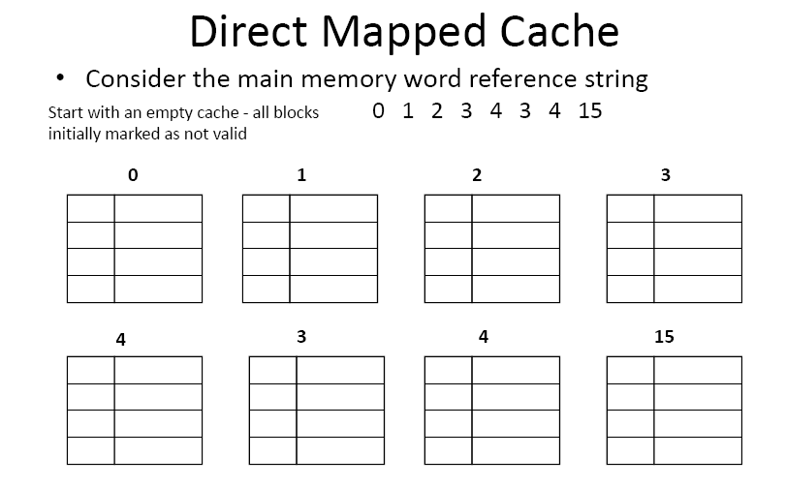

Slide 16
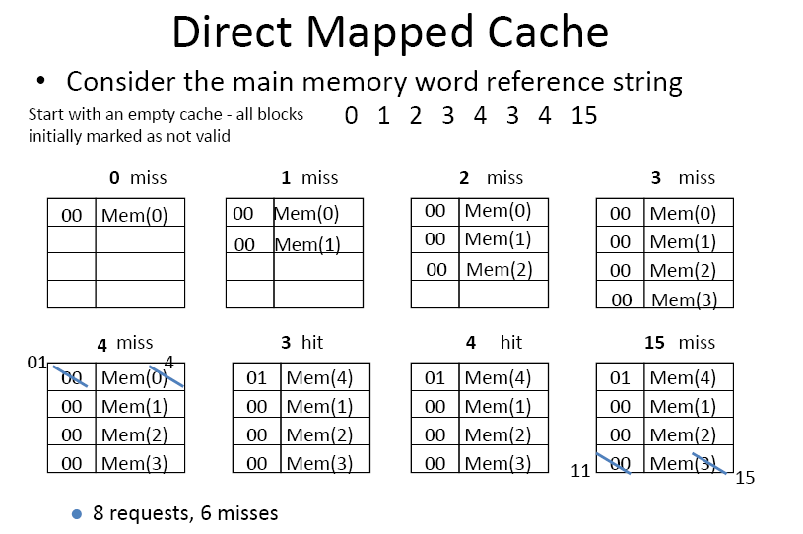

Slide 17
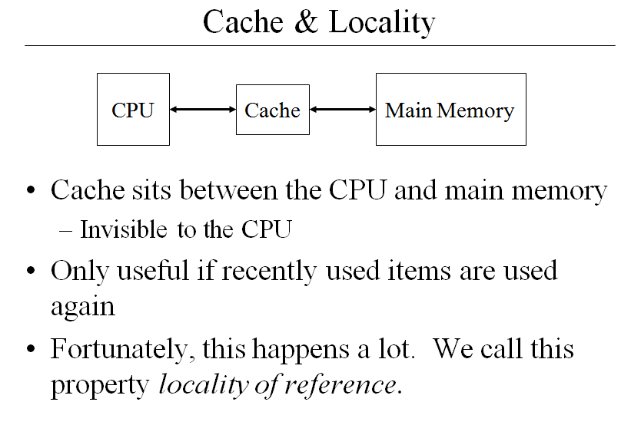

Slide 18
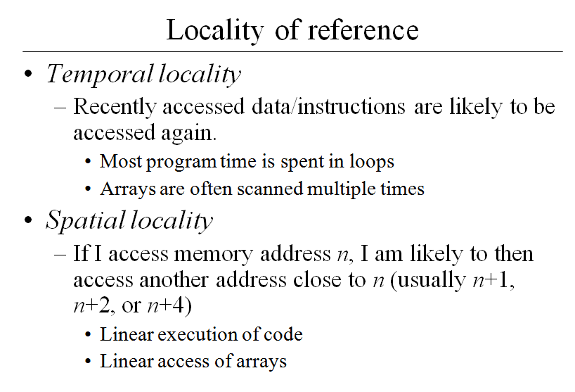

Slide 19
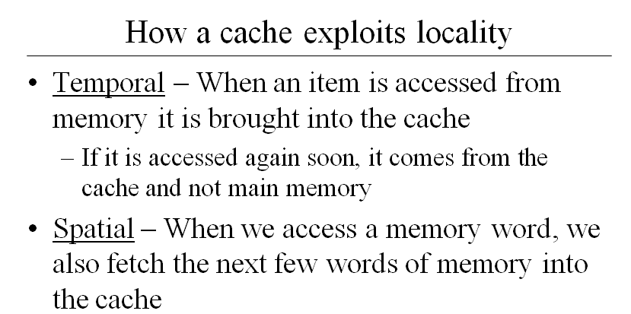

Slide 20
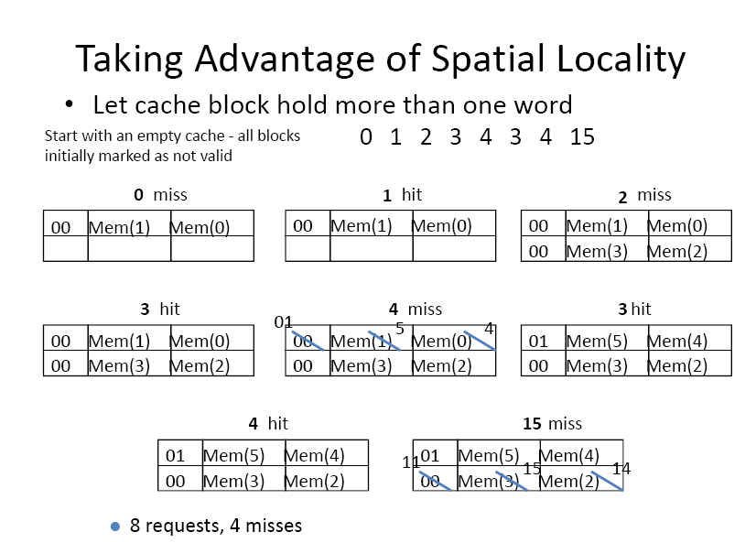
Example

Slide 21
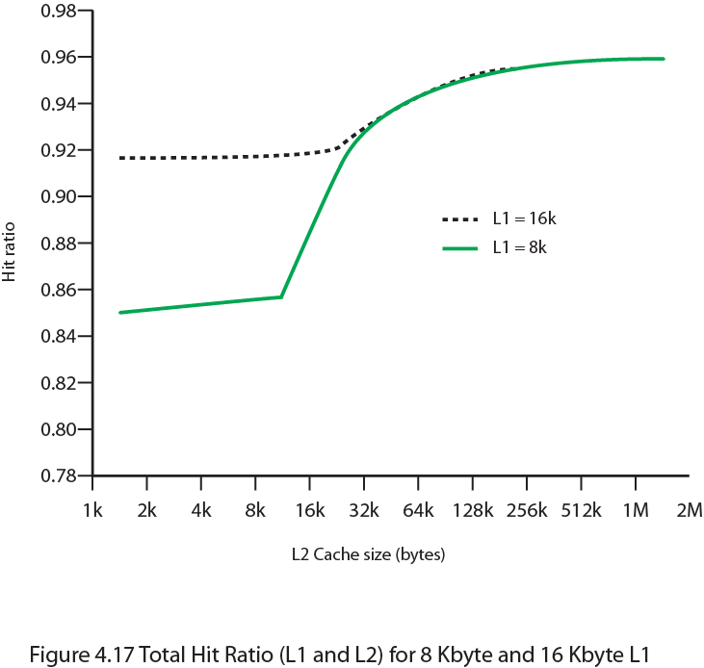
Hit Ratio (L1 & L2) For 8 kbytes and 16 kbyte L1

Slide 22
Unified v Split Caches
One cache for data and instructions or two, one for data and one for instructions
Advantages of unified cache
Higher hit rate
Balances load of instruction and data fetch
Only one cache to design & implement
Advantages of split cache
Eliminates cache contention between instruction fetch/decode unit and execution unit
Important in pipelining

Slide 23
Pentium 4 Cache
80386 – no on chip cache
80486 – 8k using 16 byte lines and four way set associative organization
Pentium (all versions) – two on chip L1 caches
Data & instructions
Pentium III – L3 cache added off chip
Pentium 4
L1 caches
8k bytes
64 byte lines
four way set associative
L2 cache
Feeding both L1 caches
256k
128 byte lines
8 way set associative
L3 cache on chip

Slide 24
Pentium 4 Design Reasoning
Decodes instructions into RISC like micro-ops before L1 cache
Micro-ops fixed length
Superscalar pipelining and scheduling
Pentium instructions long & complex
Performance improved by separating decoding from scheduling & pipelining
(More later – ch14)
Data cache is write back
Can be configured to write through
L1 cache controlled by 2 bits in register
CD = cache disable
NW = not write through
2 instructions to invalidate (flush) cache and write back then invalidate
L2 and L3 8-way set-associative
Line size 128 bytes

Slide 25
ARM Cache Features
Core | Cache Type | Cache Size (kB) | Cache Line Size (words) | Associativity | Location | Write Buffer Size (words)
ARM720T | Unified | 8 | 4 | 4-way | Logical | 8
ARM920T | Split | 16/16 D/I | 8 | 64-way | Logical | 16
ARM926EJ-S | Split | 4-128/4-128 D/I | 8 | 4-way | Logical | 16
ARM1022E | Split | 16/16 D/I | 8 | 64-way | Logical | 16
ARM1026EJ-S | Split | 4-128/4-128 D/I | 8 | 4-way | Logical | 8
Intel StrongARM | Split | 16/16 D/I | 4 | 32-way | Logical | 32
Intel Xscale | Split | 32/32 D/I | 8 | 32-way | Logical | 32
ARM1136-JF-S | Split | 4-64/4-64 D/I | 8 | 4-way | Physical | 32

Slide 26
ARM Cache Organization
Small FIFO write buffer
Enhances memory write performance
Between cache and main memory
Small c.f. cache
Data put in write buffer at processor clock speed
Processor continues execution
External write in parallel until empty
If buffer full, processor stalls
Data in write buffer not available until written
So keep buffer small

Slide 27
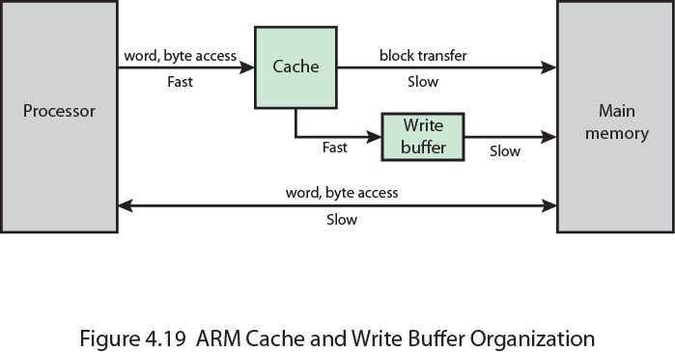
ARM Cache and Write Buffer Organization

Slide 28
Review Questions
What are the differences among sequential access, direct access, and random
access?
What is the general relationship among access time, memory cost, and capacity?
How does the principle of locality relate to the use of multiple memory levels?
What is the distinction between spatial locality and temporal locality?
In general, what are the strategies for exploiting spatial locality and temporal
locality?

Slide 29
Thank you

